Slide 1

The Future of Cars: Autonomous and Concept Vehicles
Timofei Tsypyshev IU5-31B

Slide 2
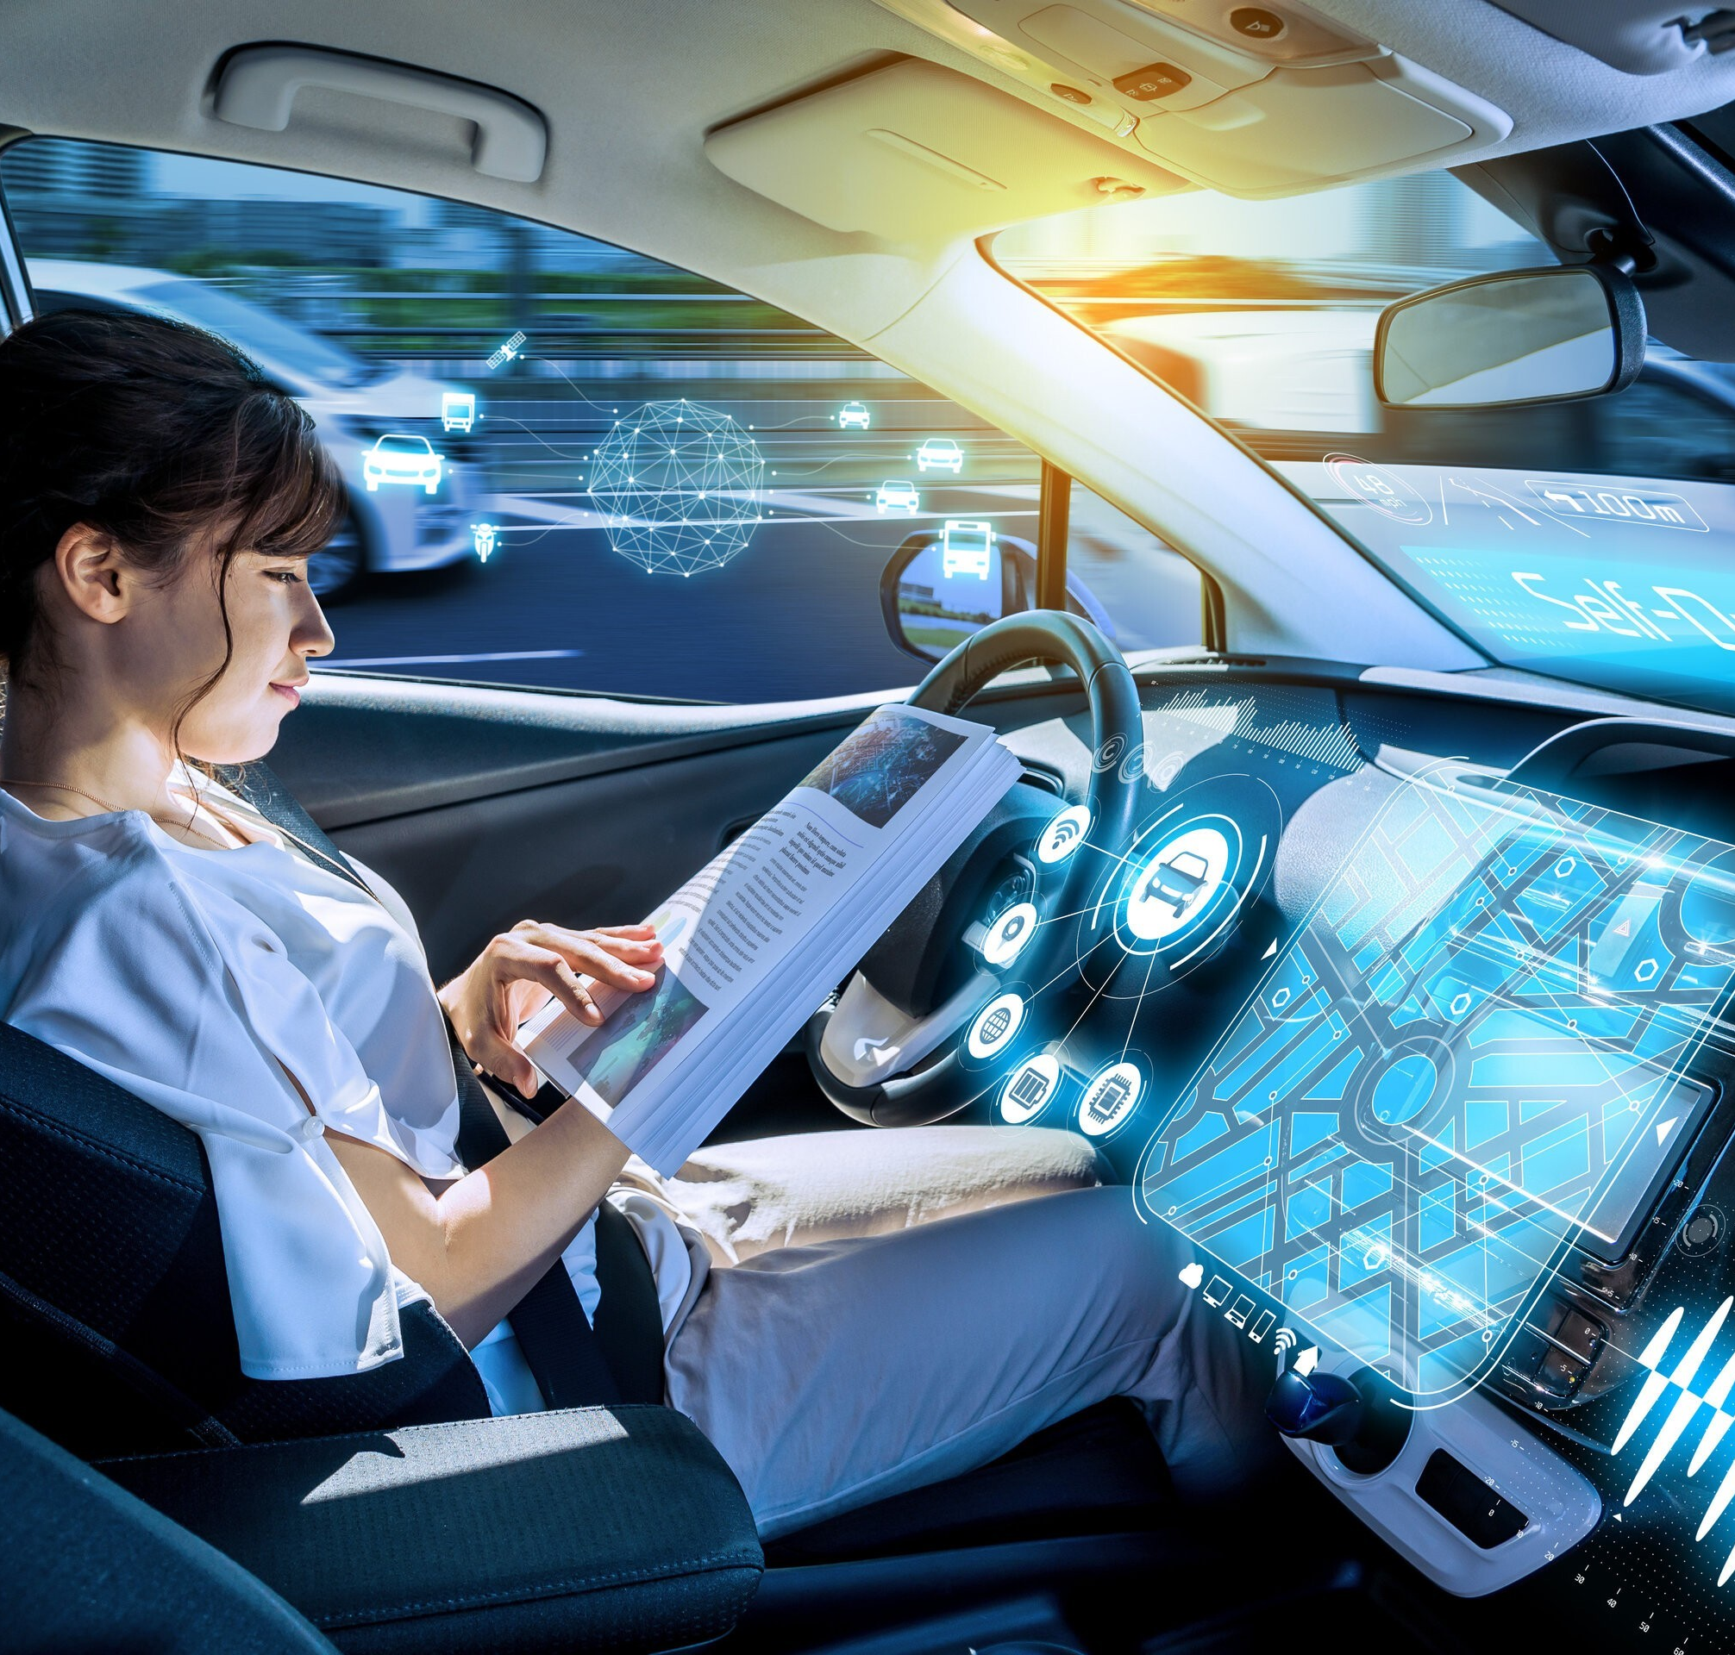
Introduction
Welcome to the future of cars! In this presentation, we'll explore the exciting world of autonomous and concept cars. These are the vehicles that are changing the way we think about driving.

Slide 3

Presentation Outline
1. Autonomous Cars
2. How Do They Work?
3. Benefits of Autonomous Cars
4. Concept Cars
5. Conclusion
6. Questions

Slide 4
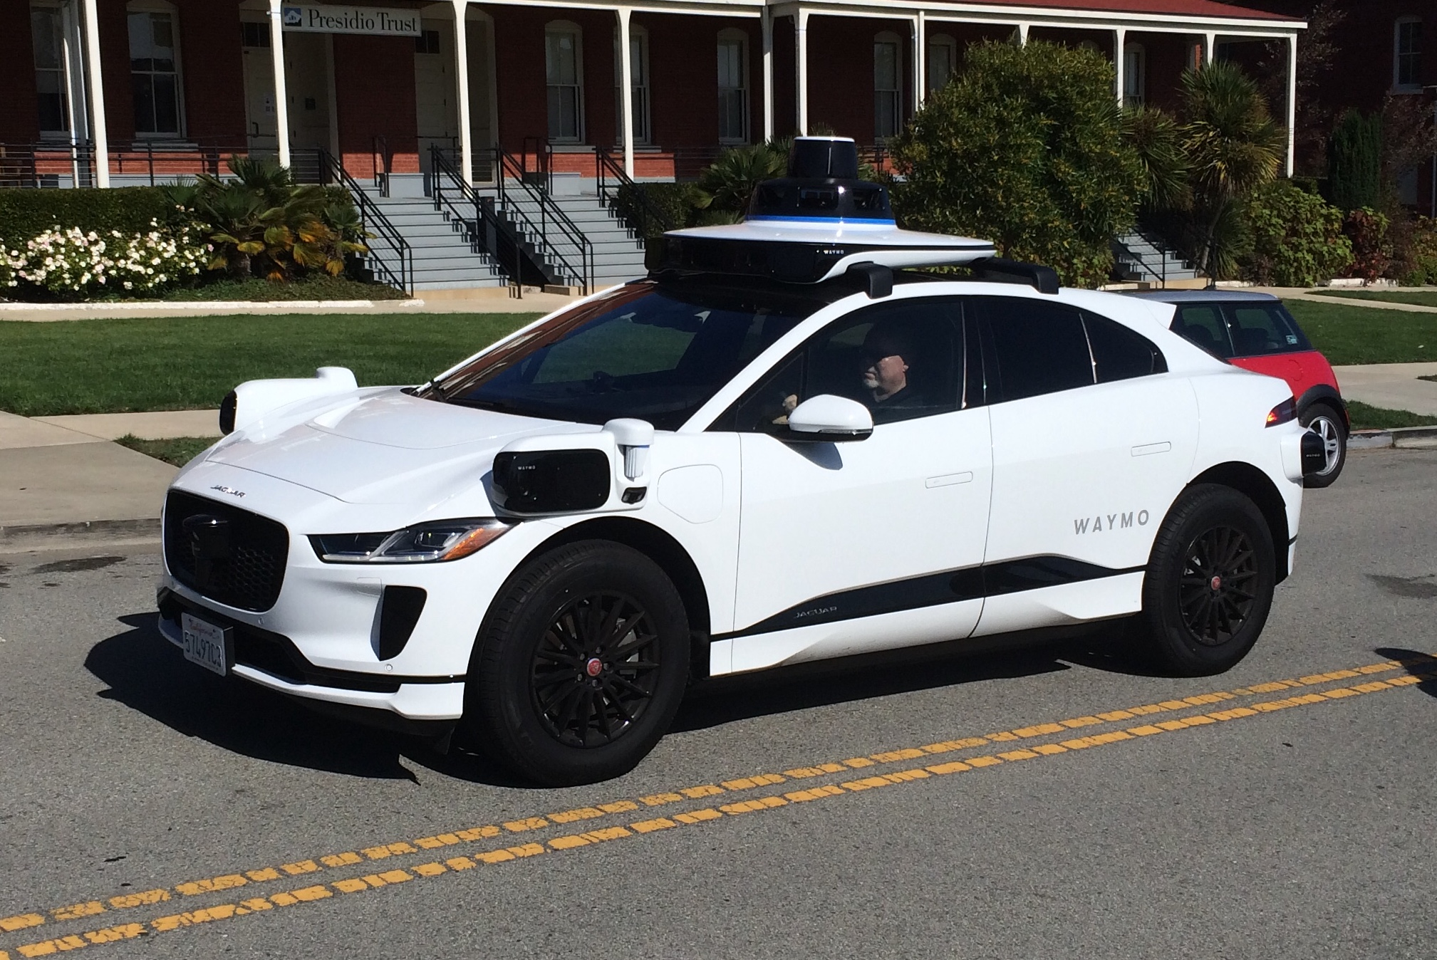
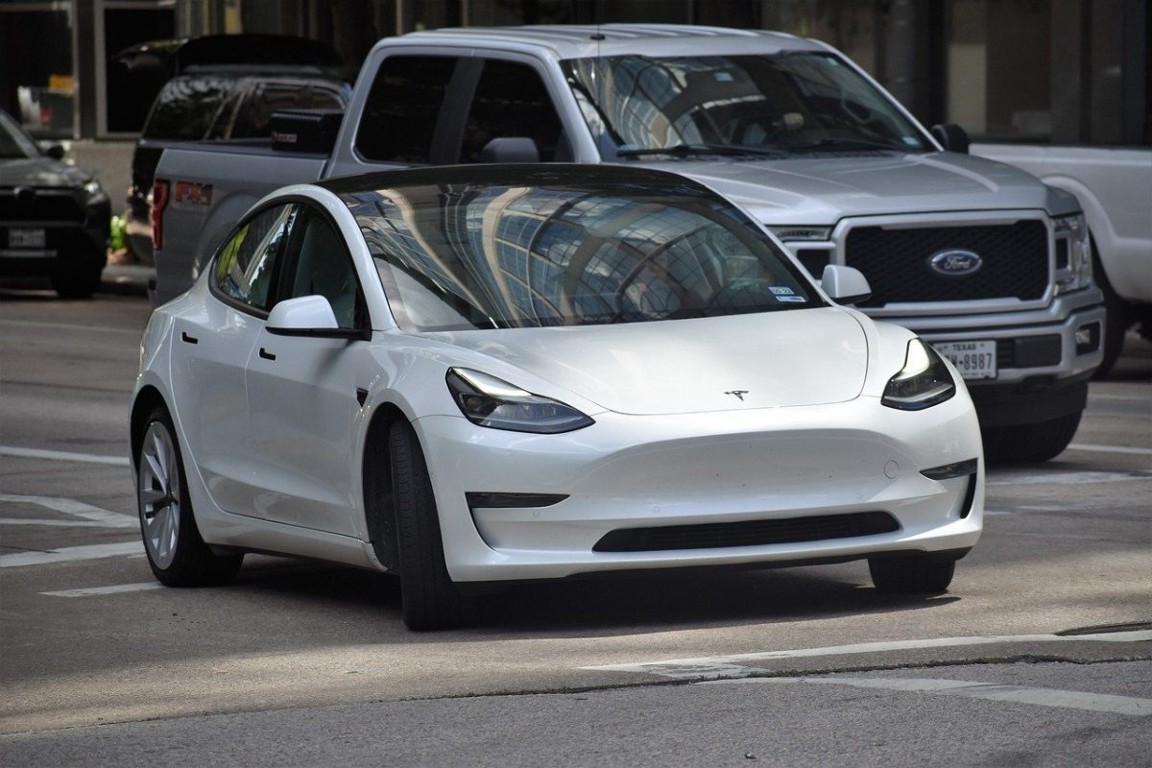
Autonomous Cars
Waymo
General Motors
Tesla

Slide 5

How Do They Work?

Slide 6

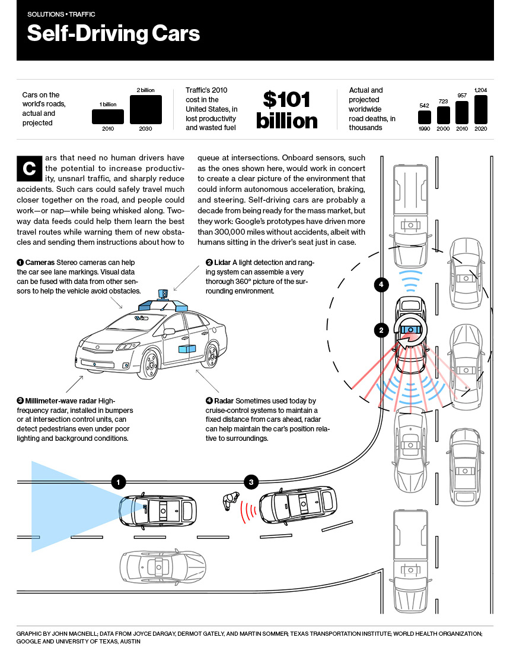
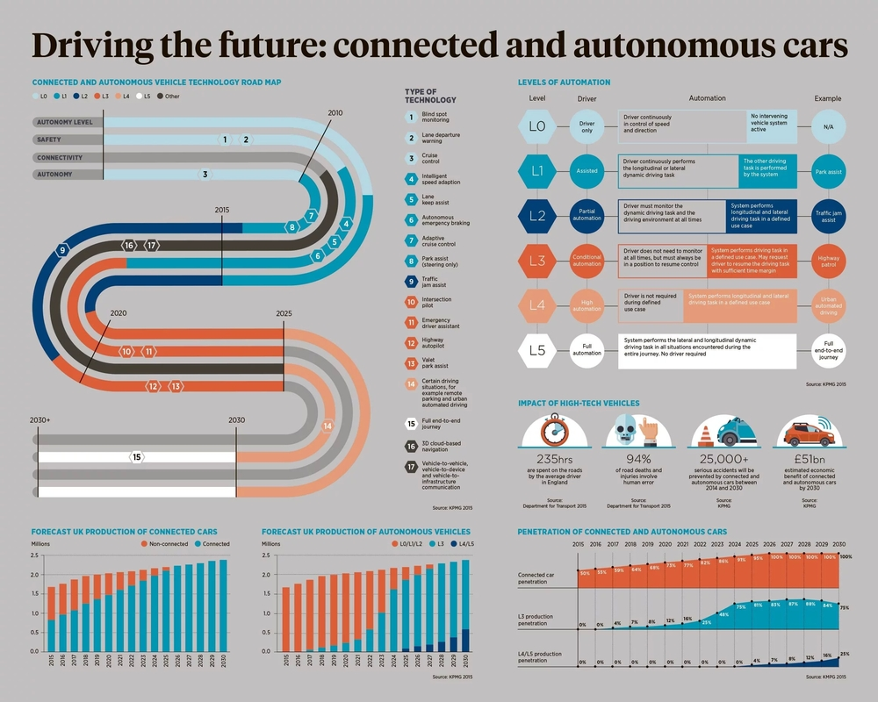
6

Slide 7
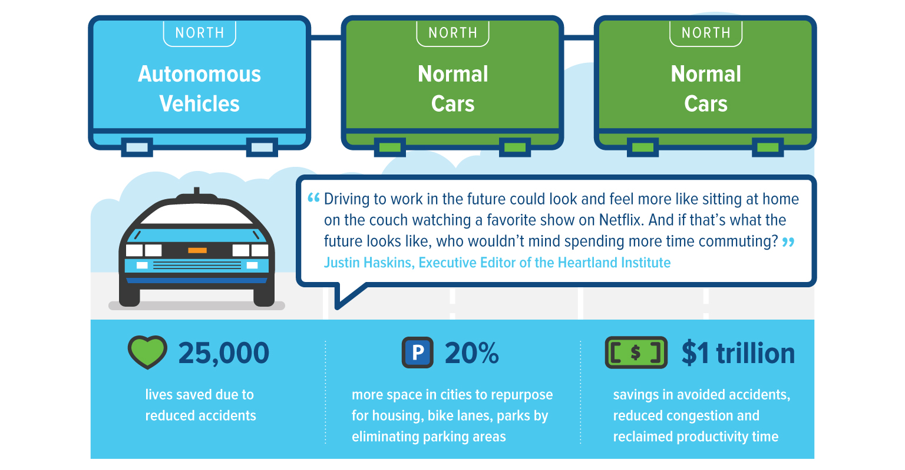
Benefits of Autonomous Cars

Slide 8

Conclusion

Slide 9

Questions
1. What are some benefits of autonomous cars mentioned in Slide 7?
2. Which companies are mentioned as leaders in the development of autonomous cars in Slide 4?

Slide 10

Thank you for your attention!

